Slide 1
Machine Learning Skyrmions
Han, JungHoon (SKKU)

Slide 2
FLOW of talk
Flavor of Machine Learning (ML)
New Ways to Analyze Experimental Data (inspired by ML)
ML+Ising (review)
ML + Heisenberg (our work)
Statistical Recovery of Hamiltonian (our work)

Slide 3
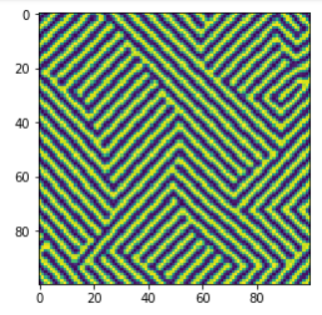
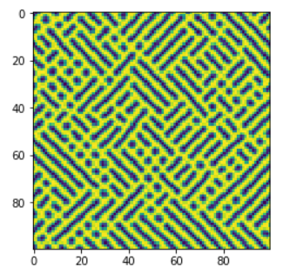
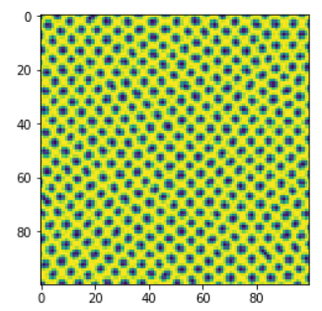
Show these pictures (pixels) to computer and ask: “Computer, computer, what do you see?”
Computer says: I see a spiral (top), skyrmion (bottom), mixed spiral+skyrmion (middle).
In short, this is machine learning (ML)
How does a computer know?
Label = spiral (0), skyrmion (1)
Training = develop an algorithm that decides which label is to be given to a given input picture

Slide 4
Try to find a function F(x₁, y₁,…, x_{N}, y_{N}) that predicts
F(
)= 0 or 1
F(x₁, y₁,…, x_{N}, y_{N}) is some horribly nonlinear function of input variables (no one knows the structure of F for sure. It’s a black box for now.)
Key to ML is that we don’t decide what this function is; we let machine decide it (this process is called training)

Slide 5
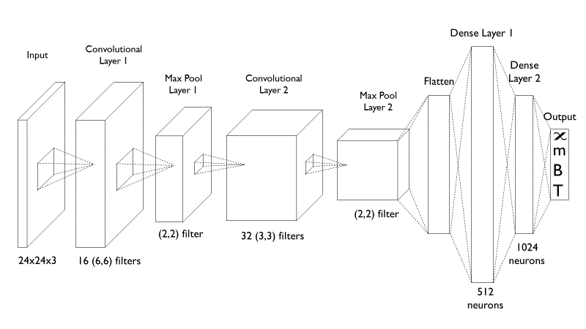
HOW TO WRITE DOWN FUNCTION in ML
)= 0 or 1
F(x,y)=
It’s like a factory whose inner workings we are not allowed to observe

Slide 6

Gradient Descent
Write down initial, random guess for F(x₁, y₁,…, x_{N}, y_{N})
Tweak coefficients (millions of them!) to match answers better
Once F(X,Y) is found, you feed in some new input picture, the algorithm will tell you whether F(X,Y)=0 or F(X,Y)=1, i.e. whether the picture is that of spiral or skyrmion

Slide 7
PoSsible mARRIAGE of MC, ML & Exp
Develop fitting function F(x₁, y₁,…, x_{N}, y_{N}) based on Monte-Carlo generated pictures like
After good training, feed real-life experimental image like
Let the machine decide what this is
Why use MC? So easy to generate lots of training data!

Slide 8
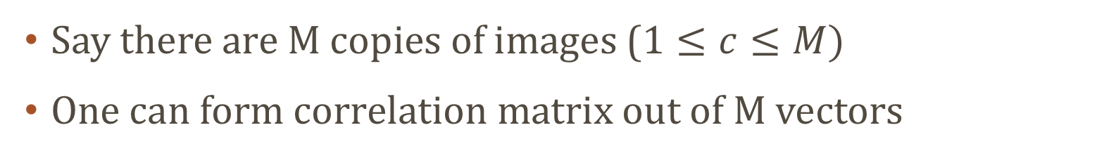
ML-INSPIRED DATA ANALYSIS: PCA (Principal component analysis)
Each exp. image is a vector
Say there are M copies of images ($1≤c≤M)$
One can form correlation matrix out of M vectors
Why correlation matrix?

Slide 9
This is not widely known; could be useful way to generate correlation functions from MFM, SP-STM, LTEM data
Correlation matrix is Hermitian; diagonalized with real eigenvalues
Only small number of eigenvalues are dominant
Leads to a concept of “eigen-images” and eigen-image expansion:

Slide 10
TESTING OUT with MC-generated data set
Prepare ~ 1000 configurations
Each image is 7500-dim vector
After PCA, only ~100 eigenvalues & eigenimages are relevant
Great reduction in the number of “relevant” information
Possible use in deducing correlation function from surface image data (normally delegated to neutron exp)

Slide 11
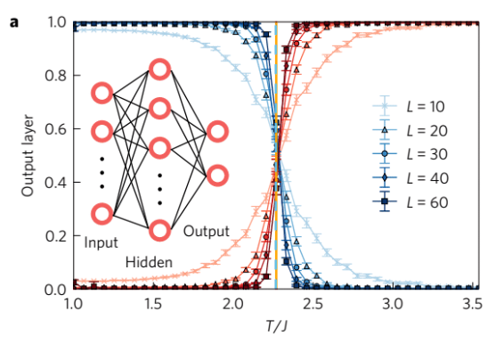
ML analysis of Ising model
Ising model (2D) supports two phases: ordered (0) and disordered (1)
Develop ML-generated function f() with two outputs 0, or 1
When states near critical temperature are fed into this function, the output is sometimes 0, sometimes 1
Melko et al. plotted evolution of probability with temperature (Nat. Phys. 2017)
Accurate determination of critical temperature (no one knows why)

Slide 12
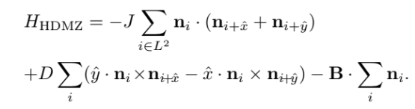
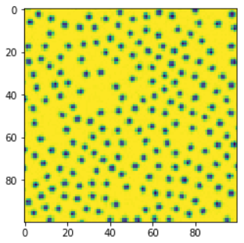
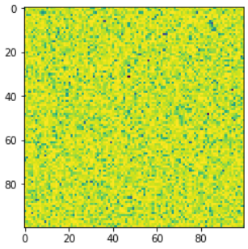
ML analysis of HDMZ Model
B

Slide 13
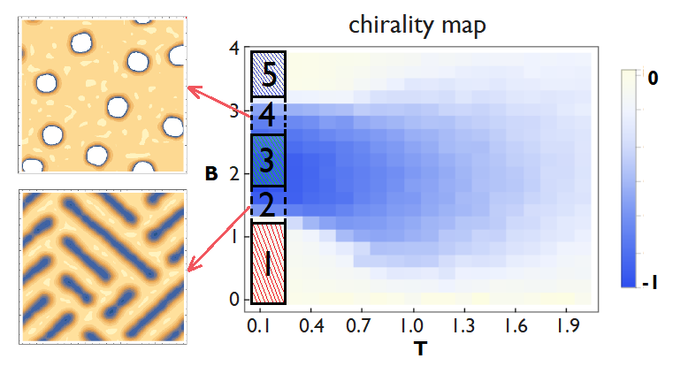
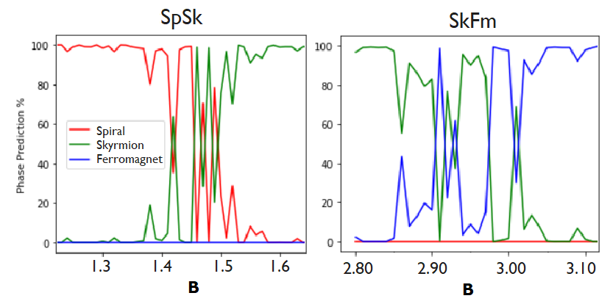
Phase Prediction – disaster!
1=Spiral (Sp)
2=Spiral+Skyrmion (SpSk)
3=Skyrmion (Sk)
4=Skyrmion+Ferromagnetic (SkFM)
5=Ferromagnetic (Fm)
Over the mixed-phase region, the prediction fluctuates wildly
Recall, this is NOT second-order; this is first-order mixed-phase

Slide 14
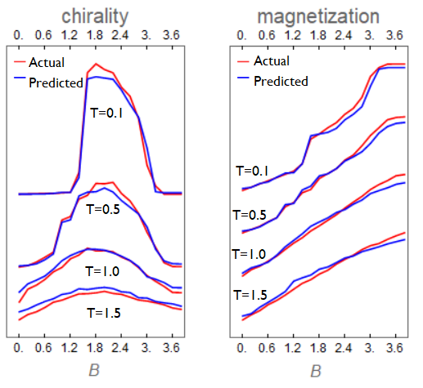
A NEW STRategy: Feature Prediction – huge success!
Train new function f() whose output is spin chirality and magnetization, magnetic field, temperature

Slide 15
Remember: we never taught the chirality formula, nor the magnetization formula. Machine somehow picked it up.
After all, this could have been done much more easily, because there is a formula for them
Can we teach machine to predict something for which there is no formula?
We show a picture, and ask for (B,T) at which the picture was taken

Slide 16
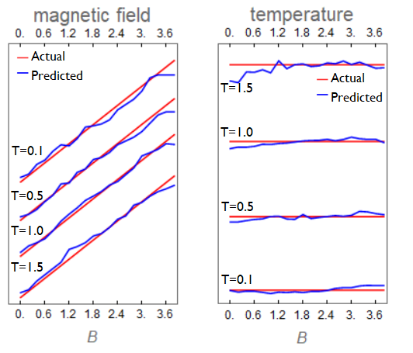
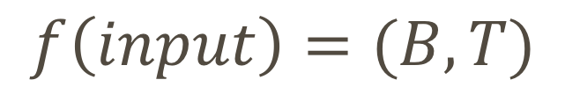
Feature Prediction of thermodynamic quantities
Train new function f() whose output is magnetic field, temperature
$$f\left(input\right)=(B,T)$$
Maybe worth thinking about lab application of the scheme

Slide 17
Statistical recovery of hamiltonian
This is not ML; only the idea of gradient descent is borrowed from ML
What we do in CM lab: We measure something, fit it to some simple model, not knowing for sure whether the model is in one-to-one match to the actual sample
Representative (spin) models are Ising, XY, Heisenberg, and its further-neighbor and biquadratic extensions
Suppose we are dealing with Ising magnet with many neighbor interactions

Slide 18
How do we find J1, J2, J3, etc?
One method is neutron diffraction. Measure magnon dispersion and fit to theory (quite popular method indeed)
What if the sample is 2D and very hard to do neutron exp. on?

Slide 19
invoking simple thermodynamic identity

Slide 20
With knowledge of specific heat and four-point correlation function, one can determine J’s by least-square fitting |LHS-RHS |.

Slide 21
Four-point correlation function data could come from surface data of SP-STM, MFM
Heat capacity measurement of 2D material is not out of reach
Might be worth a try!

